Slide 1
Employee Attrition Rate Analysis
By
Ramasubramanian Subramanian
09/10/2023

Slide 2
Overview and problem statement
Employee retention strategies are integral to the success and well-being of a company.
There are often many reasons why employees leave an organization, and in this case study, I will explore some of the key drivers of employee attrition.
Employee attrition measures how many workers have left an organization and is a common metric companies use to assess their performance.
While turnover rates vary from industry to industry, the Bureau of Labor Statistics reported that among voluntary separations the overall turnover rate was 25% in 2020

Slide 3
Data analyzed
In this experiment, I will explore IBM's dataset on HR Analytics. The data consists of nearly 1,500 employees with information related to their job satisfaction, work life balance, tenure, experience, salary, and demographic data. Below is a brief overview and summary statistics of the data.
Dataset Link: https://www.kaggle.com/datasets/pavansubhasht/ibm-hr-analytics-attrition-dataset

Slide 4
Hypothesis Testing
Independent T-Test To compare the average monthly income among current and former employees, I'll perform an independent t-test. This will allow us to determine whether there is a statistically significant difference between the average incomes of the two populations. To test this, I'll use the log-transformed data since one of the assumptions of the test is that the continuous variable is approximately normally distributed.
Hypothesis:
H0: The null hypothesis for the t-test is that the average monthly income of former employees is the same as current employees. u1=u2
H1: The alternative hypothesis is that the average monthly income of former employees is different than current employees. u1≠u2

Slide 5
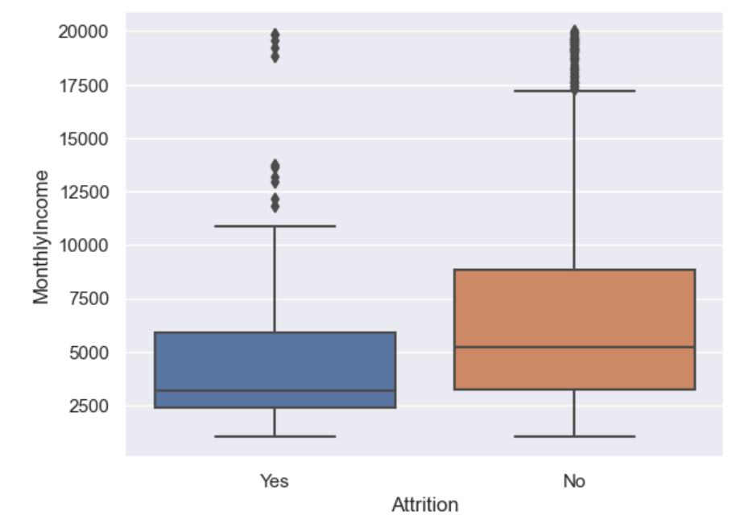
Statistically significant difference between Former and Current Employees monthly income:
Based on p-value of the T-Test is 0, which is less than our significance level, 0.05. Therefore, there is evidence to support that the average monthly income of former employees is different than the average monthly income of current employees.
With 95% confidence, the average monthly income is between 1509.80 and 2581.48

Slide 6

Conclusion
In this analysis, we found that among former employees, salary was found to be significantly lower, with a median monthly income about $2,000/month less than current employees.
This analysis will help the companies to understand one of the reason for the attrition and take the necessary action to retain the employees

Slide 7
Questions?

Slide 8
Thank You

